Slide 1
\LaTeX
For Scientific Documentation
By Ammar Taha Mohamedy
Drawing Figures Part 1

Slide 2
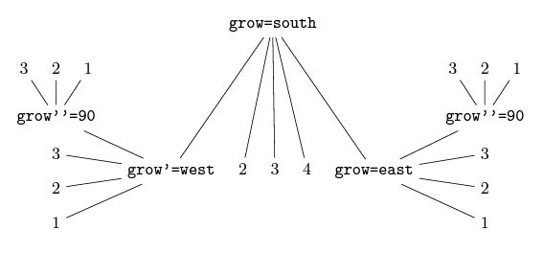
LaTeX Graphics Potential
1
Basic Shapes
2
Variations of Trees

Slide 3
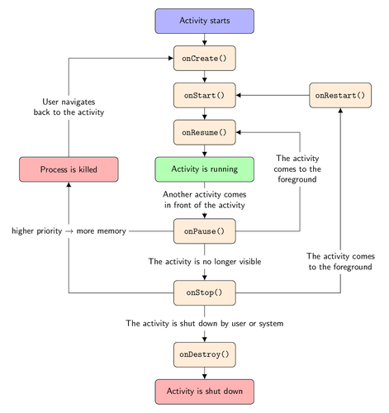
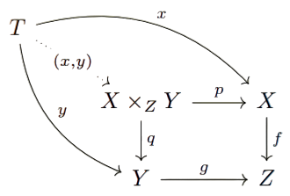
LaTeX Graphics Potential
3
Flowcharts
4
Commutative Diagrams

Slide 4
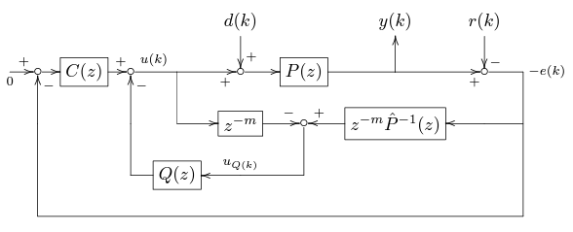
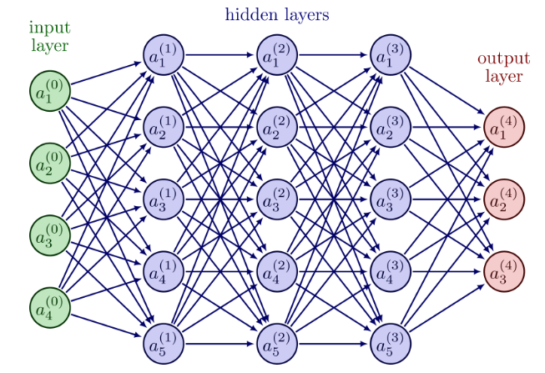
LaTeX Graphics Potential
5
Block Diagrams
6
Neural Networks

Slide 5
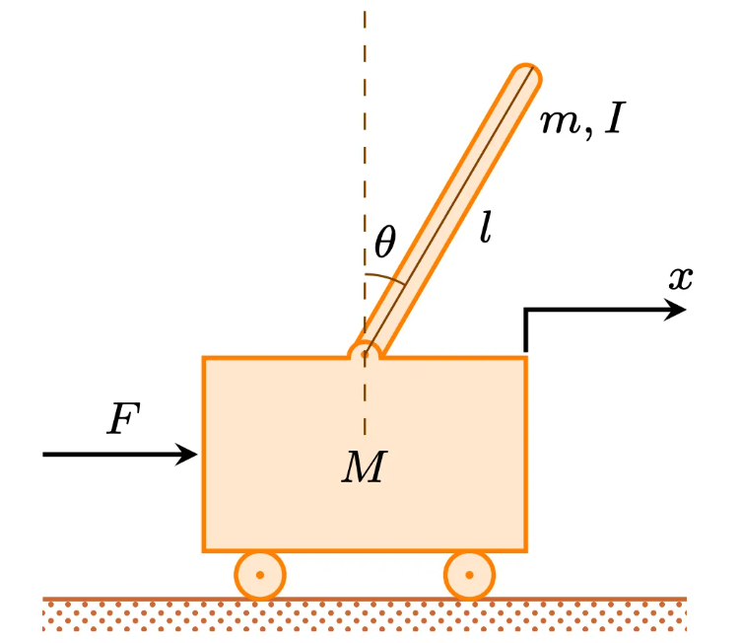
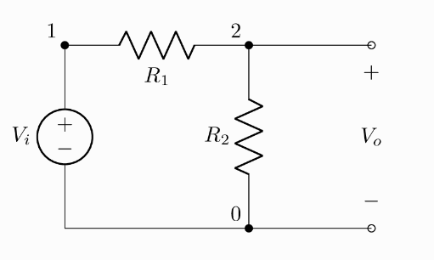
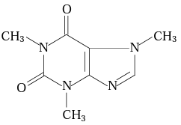
LaTeX Graphics Potential
7
Mechanical Diagrams
8
Electrical Circuits
9
Chemical Structures

Slide 6
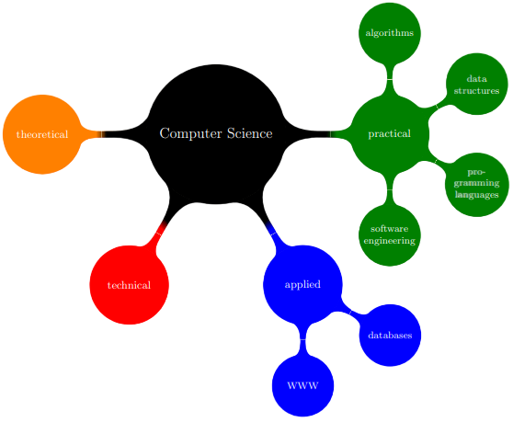
LaTeX Graphics Potential
10
Mindmaps

Slide 7
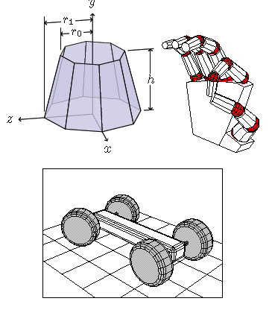
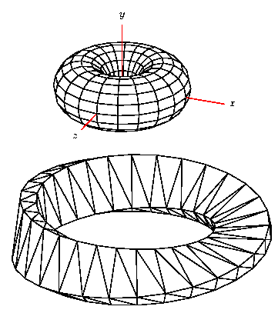
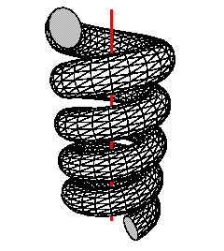
LaTeX Graphics Potential
3D Structures

Slide 8
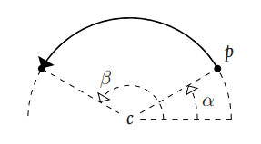
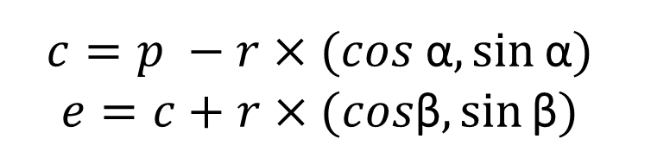
Drawing Arcs
\draw (Start Point[p]) arc (α:β:r);
α: The Angle of Start Point.
β: Angle of the End Point.
r: Radius of The Circle Holding the Arc.
e
$$c=p −r×(cos \text{α},\sin{\text{α}})$$
$$e=c+r×(cos\text{β},\sin{\text{β}})$$

Slide 9
Thanks for Watching !!

